Slide 1

PES’s Modern College of Engineering, Shivajinagar, Pune-5. Department of Electronics and Telecommunication
American Standard Sign Language Representation Using Speech Recognition
Amruta Bhujbal
Priya Khandagale
Pradnya Balwadkar
Name of The Guide-Mrs.H.V Kanitkar
American Standard Sign Language Representation Using Speech Recognition

Slide 2
PES’s Modern College of Engineering, Shivajinagar, pune-5. Department of Electronics and Telecommunication
Overview :
Introduction
Literature Survey
System Specifications
Block Diagram
Hardware Design
Software Design(Flowchart and algorithm)
Result
Applications
Future scope
Conclusion
References
American Standard Sign Language Representation Using Speech Recognition

Slide 3
PES’s Modern College of Engineering, Shivajinagar, pune-5. Department of Electronics and Telecommunication
Introduction:
Aims
- Our idea behind this project is to help the deaf and the dumb
- Recognizing spoken words
- Represents the words using American standard sign language
-Via a robotic arm.
-The application uses MATLAB to achieve it.
American Standard Sign Language Representation Using Speech Recognition

Slide 4
PES’s Modern College of Engineering, Shivajinagar, Pune-5. Department of Electronics and Telecommunication
Literature Survey:
To communicate with deaf and dumb person
- Existing method
1. Lip reading
2. Writing Word
3. Finger Spelling
Speech Recognition technique
-HMM: Hidden Markov Model.
-ANN : Artificial Neural Network.
-MFCC: Mell frequency Cepstral
American Standard Sign Language Representation Using Speech Recognition

Slide 5
PES’s Modern College of Engineering, Shivajinagar, pune-5. Department of Electronics and Telecommunication
Introduction to A-S-S-L:
1.American standard sign language
- Demonstrated in 1980
- United State
2.Uses hand movements .
3.Full fill all of the requirements for human languages.
American Standard Sign Language Representation Using Speech Recognition

Slide 6
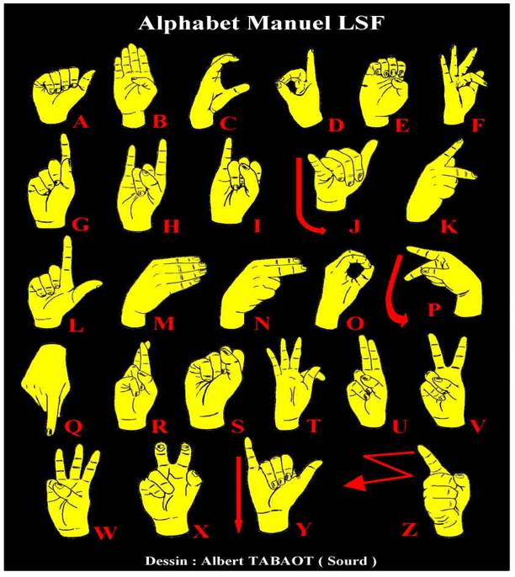
PES’s Modern College of Engineering, Shivajinagar, Pune-5. Department of Electronics and Telecommunication
A-S-S-L Signs
American Standard Sign Language Representation Using Speech Recognition

Slide 7
System Specifications
PES’s Modern College of Engineering, Shivajinagar, pune-5
Department of Electronics and Telecommunication
We are providing input through mike.
Maximum word length- 8 Alphabets
Maximum input time – 3Sec.
Recognized Alphabets (2D)-[A,B,G,H,I,S,U,W,L,Y]
Voltage for ARM7 is +3.3V
5 servo motor (VTS -05A, Voltage-4.8v
Torque-1kg)
American Standard Sign Language Representation Using Speech Recognition

Slide 8
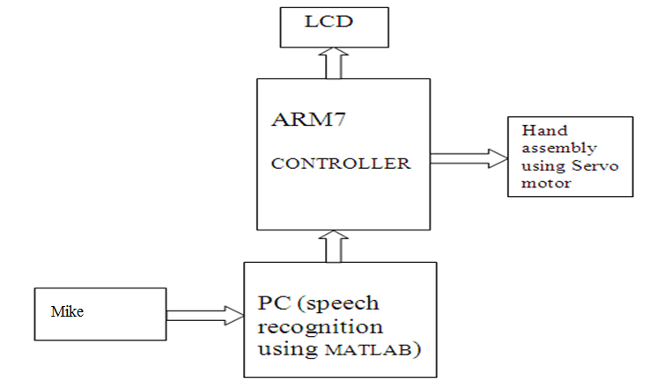
PES’s Modern College of Engineering, Shivajinagar, Pune-5. Department of Electronics and Telecommunication
Block Diagram:
American Standard Sign Language Representation Using Speech Recognition

Slide 9
PES’s Modern College of Engineering, Shivajinagar, Pune-5. Department of Electronics and Telecommunication
Hardware Design:
MAX 232-Logic level converter.
Power supply-5 V.
LM 1117-Voltage Regulator
ARM 7-LPC 2138
LCD-16 X 2
Servo Motor- VTS-05A
American Standard Sign Language Representation Using Speech Recognition

Slide 10
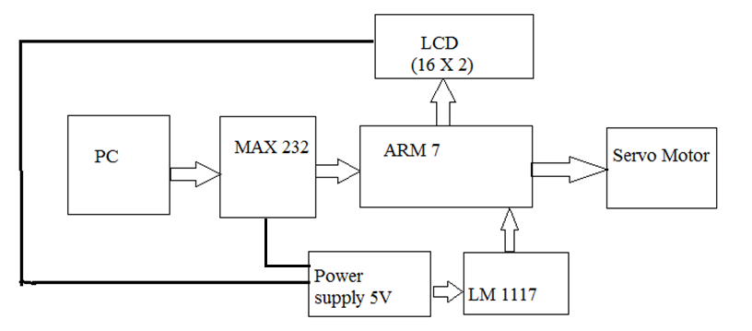
PES’s Modern College of Engineering, Shivajinagar, Pune-5. Department of Electronics and Telecommunication
Block diagram:
American Standard Sign Language Representation Using Speech Recognition

Slide 11
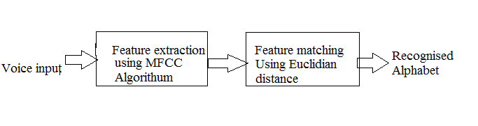
PES’s Modern College of Engineering, Shivajinagar, Pune-5. Department of Electronics and Telecommunication
Software Design:
American Standard Sign Language Representation Using Speech Recognition

Slide 12
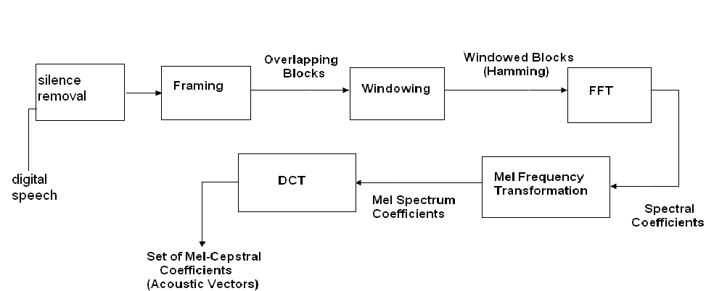
PES’s Modern College of Engineering, Shivajinagar, Pune-5. Department of Electronics and Telecommunication
MFCC Block Diagram
American Standard Sign Language Representation Using Speech Recognition

Slide 13
PES’s Modern College of Engineering, Shivajinagar, Pune-5. Department of Electronics and Telecommunication
Algorithm(Feature Extraction)
Silence Removal : Extracting Noise.
Framing: Over lapping Framing.
Windowing: To avoid DSP artifact
FFT: Frequency Domain.
MELL Frequency wrapping: ‘Mel’ scale.
DCT: MELL Cepstral Coefficient
American Standard Sign Language Representation Using Speech Recognition

Slide 14
PES’s Modern College of Engineering, Shivajinagar, Pune-5. Department of Electronics and Telecommunication
Feature Matching
1.Vector Quantization: This technique is used to minimize the amount of data to be handled.
2.Euclidean Distance :Compares distance between input character and store character in database ,which has least distance it is
recognized character.
American Standard Sign Language Representation Using Speech Recognition

Slide 15
Result:
Software result
In MFCC feature extraction and matching done.
After matching character or word it pass serially to hardware
Hardware result
LCD display
Hand movement of latter displayed on LCD
American Standard Sign Language Representation Using Speech Recognition

Slide 16
PES’s Modern College of Engineering, Shivajinagar, Pune-5. Department of Electronics and Telecommunication
Application:
Public places
-Airports
- Railway stations
-Counters of banks
- Hotels
Primary education of deaf and dump people.
American Standard Sign Language Representation Using Speech Recognition

Slide 17
Future Scope
By American Standard Sign Language with speech recognition ,it is possible to speak directly with a robot without any physical engagement to communicate with the dumb and deaf easily
It is easily possible to make a software package to automatically install in video and movie services with the help of set top box and record the speech words and at the time of testing (playing the movie) represent the sign language by animated hand at the corner of screen.
American Standard Sign Language Representation Using Speech Recognition

Slide 18
PES’s Modern College of Engineering, Shivajinagar, pune-5. Department of Electronics and Telecommunication
Conclusion:
With the help of this project
-Normal people can communicate with deaf and dumb peoples
- Reduces the communication gap
To provide education
- People who have problem in speaking and hearing the words.
American Standard Sign Language Representation Using Speech Recognition

Slide 19
PES’s Modern College of Engineering, Shivajinagar, Pune-5. Department of Electronics and Telecommunication
References:
IEEE Paper
Speaker Identification Using Mel Frequency Cepstral `Coefficients
Md. Rashidul Hasan, Mustafa Jamil, Md. Golam Rabbani Md. Saifur Rahman 28-30December 2004, Dhaka, Bangladesh
Andrew S.Sloss,”Arm system Developer”
Websites:
www.ieeexplore.com
www.datasheet.com
American Standard Sign Language Representation Using Speech Recognition

Slide 20

PES’s Modern College of Engineering, Shivajinagar, Pune-5. Department of Electronics and Telecommunication
American Standard Sign Language Representation Using Speech Recognition

Slide 21
PES’s Modern College of Engineering, Shivajinagar, Pune-5. Department of Electronics and Telecommunication
Thank you….
American Standard Sign Language Representation Using Speech Recognition

